Slide 1
Cybersecurity & Cyber Resilience
Presentation for Risk Management Forum, Jordan, January 2022
Nader Qahoush, CISA,CISM,CGEIT,CRISC,CDPO

Slide 2
نادر قاحوش
مستشارا في إدارة المخاطر وأمن المعلومات لعدد من مجالس إدارات مؤسسات مصرفية محلية وإقليمية.
الرئيس التنفيذي لمؤسسة أسفار للاستشارات والتدريب.
خبير تنفيذي مصرفي لقطاع البنوك المركزية وإدارة المخاطر مع عدد من المؤسسات المنفذة لبرامج المساعدات الأميركية من 2/2020 إلى 2/2021.
عمل في البنك المركزي الأردني لمدة 25 عاما حتى تاريخ 1/1/2020، واستلم خلال العقد الأخير منصب رئيس مفتشي قطاع الرقابة المصرفية لمخاطر وحوكمة تكنولوجيا المعلومات.
الرئيس التنفيذي منذ العام 2008 لمجموعة مشاريع دولية في تنمية وتطوير بيئة الرقابة والتشريعات الناظمة للقطاع المصرفي بالتعاون مع البنوك المركزية لدول السودان واليمن وليبيا والبحرين والكويت والمملكة المتحدة وروسيا.
حاصل على درجة الماجستير في الاقتصاد من الجامعة الأردنية في العام 1998.
حاصل على درجة البكالوريوس في الاقتصاد والعلوم المالية والمصرفية من جامعة اليرموك في العام 1995، مع شهادة تقدير مرتبة الشرف الأولى.
حاصل على زمالة بلاتينية وعدة شهادات مهنية دولية في حوكمة وإدارة وتقييم مخاطر ومشاريع تكنولوجيا المعلومات (CISA, CISM, CGEIT,CRISC) من مؤسسة التدقيق والرقابة على نظم المعلومات (ISACA) في الولايات المتحدة الأميركية.
خبير في حماية وخصوصية البيانات (CDPO).
مؤلف كتاب العمل المصرفي عبر الإنترنت والناشر الدار العربية للعلوم في بيروت في العام 2000.
مدرب ومحاضر في مؤتمرات محلية وعربية ودولية بمواضيع التشريع المصرفي والرقابة وإدارة المخاطر والتدقيق والحوكمة منذ العام 2005.

Slide 3
The Evolution of Cybersecurity
Computer security, Network security, Information security, Cybersecurity.
All of these terms are used to describe the protection of information assets.

Slide 4
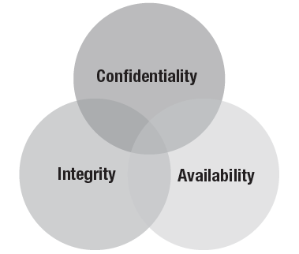
Cybersecurity Triad

Slide 5
“cybersecurity” and “information security”
The terms are often used interchangeably, but in reality cybersecurity is a part of information security.
Information security deals with information, regardless of its format—it encompasses paper documents, digital and intellectual property in people’s minds, and verbal or visual communications.
More specifically, cybersecurity can be defined as “the protection of information assets by addressing threats to information processed, stored and transported by internetworked information systems.”

Slide 6
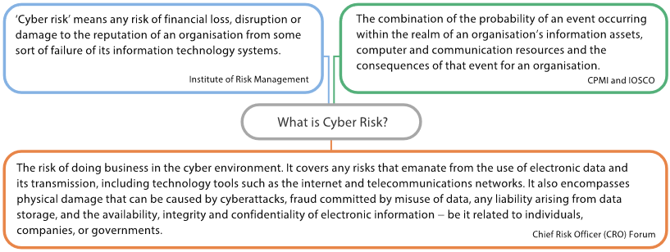
What Is Cyber Risk?
There is no globally accepted definition of cyber risk. However, the following definitions from several different organisations provide an indication of how they regard cyber risk.

Slide 7
Scale of Cyber Risk
An industry study by the Center for Strategic and International Studies and McAfee estimates that cybercrimes cost the global economy more than USD 400 billion every year, which is higher than Denmark’s Gross Domestic Product (GDP) in 2015.
The scale of cyber risk is massive. See some statistics below: Almost 60 million cybersecurity incidents were detected in 2016.
  The global average cost of a data breach in 2015 was USD 4 million.
  Five malware attacks occur every second of every day, though not all are successful.
  The average number of records lost or stolen per data breach ranges from 19,000 to 30,000.

Slide 8
Ranking of Cyber Risk
Cyber risk is ranked as one of the most critical risks. The World Economic Forum in its 2015 Global Risk Report identified technological risks as being among the top 10 risks facing the global economy.
WEF - 2022 Global Risk Report:

Slide 10
Types of Cybersecurity Incidents
Various terms are used to describe the adverse outcomes of cyber risk. In general, the term ‘cybersecurity incidents’ refers to cyberattacks and cyber incidents.
A distinguishing feature of cybersecurity incidents is the persistent nature of the campaign conducted by a motivated agent. It is often difficult to identify and fully eradicate malicious attacks.
A possible categorisation of cybersecurity incidents includes the following data breaches (the most common form of cybersecurity incident)
  point-of-sale intrusion – ATM Intrusion
  cyber espionage
  web application attacks
  payment card skimmers
  distributed denial of service (DDoS)
  cyber extortion
  ransomware

Slide 11
Data Breach
In 2015, a data breach in US health insurers, Anthem Blue Cross Blue Shield and Premera Blue Cross, exposed credit card data and personal information, including medical records, of up to 91 million policyholders.
Investigators believe that the hackers had been operating undetected within the company’s network for months.
This data breach sent a wave of panic through the healthcare industry as it exposed clients’ most sensitive and valuable personal information.

Slide 12
DDoS – Bank
In July 2015, up to 6.5 million depositors of the Royal Bank of Scotland (RBS) banking group could not access their online bank accounts for 50 minutes due to a DDoS attack.
While the RBS attack inconvenienced customers, it did not compromise accounts or put customers’ information at risk. However, RBS suffered much reputational damage as a result of the attack.

Slide 13
Global Cyberattack: WannaCry
On Friday, 12 May 2017, the “WannaCry” ransomware attack began. Within a day, it had affected more than 200,000 organisations in at least 150 countries.
As is common with this type of cyberattack, hackers lured a victim to click a link that downloaded malicious software onto a device within the computer system.
Once infected, the cyber criminals were able to take control of the entire computer system and block access to files and data until a ransom was paid.

Slide 14
Top Cybersecurity Attacks of 2021
Supply Chain Attack – SolarWinds (Orion), 33000 clients, 18000 of them infected.
SolarWinds is part of a large attack category calls “undermining software integrity.”
Mitigation: Software bill of materials, File integrity monitoring (FIM) with testing and analysis of software changes.
Threat Hunting: “It’s a really good idea to do threat hunting on a periodic and regular basis to look for things that our automated tools haven’t detected or discovered.”

Slide 15
Top Cybersecurity Attacks of 2021
Organizations increasingly rely on “red teams” to conduct active, handson attack simulations so they can measure whether their “blue teams” can detect, block, and eradicate these actions.
A purple teaming exercise is a cooperative exercise between red and blue teams, often focused on a particular threat scenario, such as the compromise of a key software package such as SolarWinds.
phishing attacks and business email compromises (BECs) - Awareness
Data exfiltration while ransomware attack – stopping file sharing features and unsecure data transfer protocols

Slide 16
Sources of Cyber Risk
Banks collect and store confidential information of individuals, for example, depositors’ personal data and borrowers’ past credit history.
Likewise, insurers collect a substantial volume of the personal data of policyholders, for example, private medical records and annual income. A breach in their databases could expose all of that data to cyber criminals.
Other sources of cyber risk to financial institutions include the following.
  Missing or Incomplete Identification of the IT Landscape
  Inadequate Controls over User Privileges
  Improper Access to Superuser Accounts
  Interconnectedness of Financial Institutions
  Internal IT Systems

Slide 17
Potential Impact of Cyber Risk
How could cyber risk impact financial institutions? Financial institutions are exposed to losses arising from cybersecurity incidents due to the following.
  Loss or Corruption of Confidential and Sensitive Data
  Financial Losses
  Business Disruption
  Reputational Damage

Slide 18
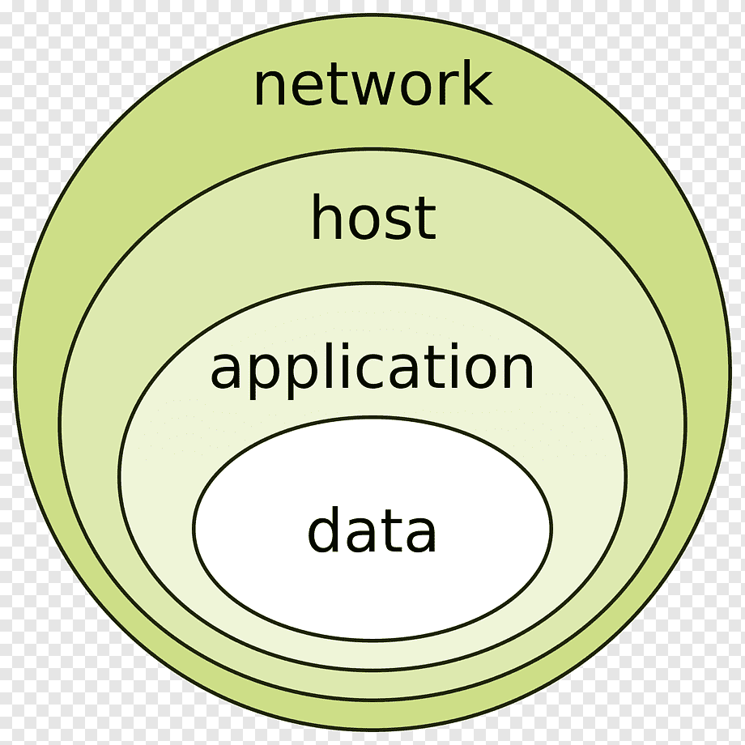
Available information technology, security process or systems
With respect to technology, there are many factors that can impact security, such as:
  Platforms and tools used
  Network connectivity (internal, third-party, public)
  Level of IT complexity
  Operational support for security
  User community and capabilities
  New or emerging security tools

Slide 19
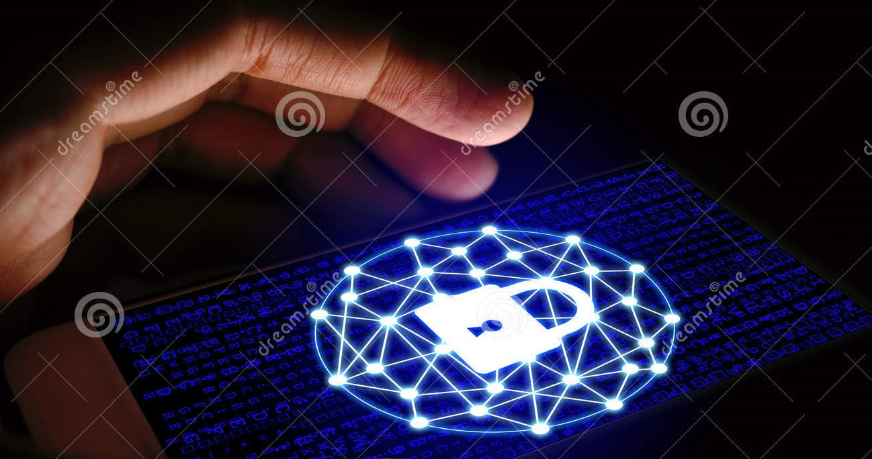
C y b e r s e c u r i t y C o n c e p t s

Slide 20
Risk
Cybersecurity controls are implemented with little or no assessment of risk.
ISACA’s recent worldwide survey of IT management, auditors and security managers consistently shows that over 80 percent of companies believe “information security risks are either not known or are only partially assessed” and that “IT risk illiteracy and
lack of awareness” are major challenges in managing risk.
Therefore, understanding risk and risk assessments are critical requirements for any security practitioner.

Slide 21
Approaches to Cybersecurity
Compliance-based—Also known as standards-based security, this approach relies on regulations or standards to determine security implementations. Controls are implemented regardless of their applicability or necessity, which often leads to a “checklist” attitude toward security.
Risk-based—Risk-based security relies on identifying the unique risk a particular organization faces and designing and implementing security controls to address that risk above and beyond the entity’s risk tolerance and business needs.

Slide 22
Approaches to Cybersecurity
Ad hoc—An ad hoc approach simply implements security with no particular rationale or criteria. Ad hoc implementations may be driven by vendor marketing, or they may reflect insufficient subject matter expertise, knowledge or training when designing and implementing safeguards.

Slide 23
Common Attack Types and Vectors

Slide 24
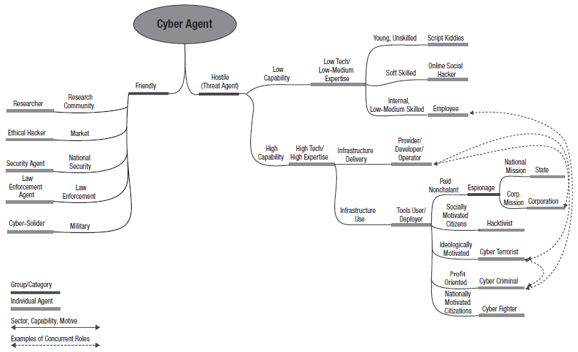
Threat Agents

Slide 25
Cyber Resilience
Cyber resilience is an institution’s ability to anticipate, withstand, contain and rapidly recover from a cyberattack.

Slide 26
Arrangements that should consider include:
Data-sharing arrangements: An institution should consider setting set up agreements with the relevant third parties or participants in case it needs to obtain uncorrupted data from them in the event of a cyberattack.
Contagion containment: In the event of a cyber incident, institution should work together with its interconnected entities to enable the resumption of critical services as soon as it is safe and practicable to do so.

Slide 27
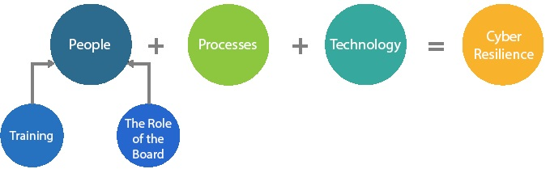
Scope of Cyber Resilience Frameworks for FMIs
The strategies and measures of a cyber resilience framework should not be restricted to securing IT operations alone, but should also cover people and processes.
Deploying the best technology against cyberattacks would be worthless if it is not supported by robust processes and competent people.

Slide 28
The Role of a Board or Equivalent
Reviewing and approving the institution’s cyber resilience framework
Ascertaining that the framework is in line with the board-approved cyber resilience strategy
Setting the institution’s tolerance level for cyber risk and ensuring that the institution operates within the risk tolerance level
Ensure the existence of the role of IT & Cybersecurity Audit for the internal & external auditor
Formulate Cybersecurity Steering Committee
Information and Cyber Security Management must report to the BOD or its delegate committee
Ensure the compliance with related laws & regulations

Slide 29
Role of Senior Management
The senior management of an institution should keep the board informed of any changes in the institution’s cyber risk register and risk profile, for example, due to changes in its products, services, policies or practices.
The board and senior management of an institution are jointly responsible for cultivating a strong level of awareness among staff from all organisational levels of the importance of maintaining cyber resilience.

Slide 30
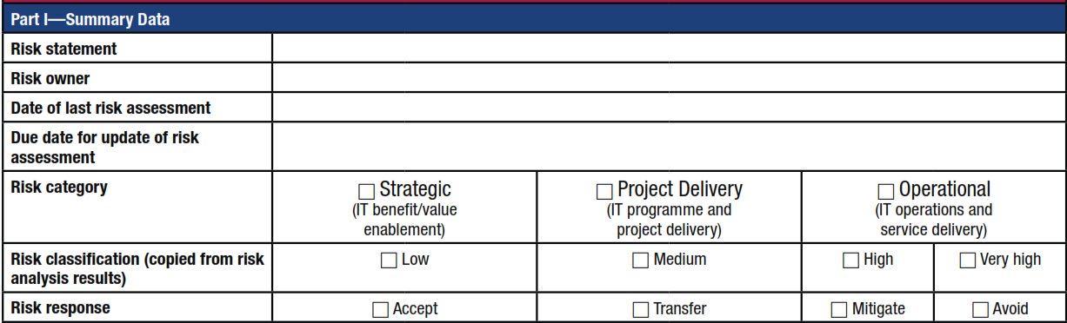
Template Risk Register Entry

Slide 31
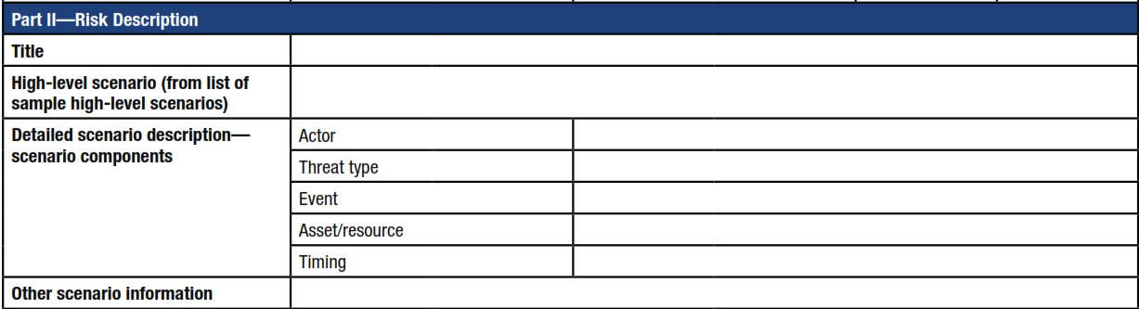
Template Risk Register Entry

Slide 32
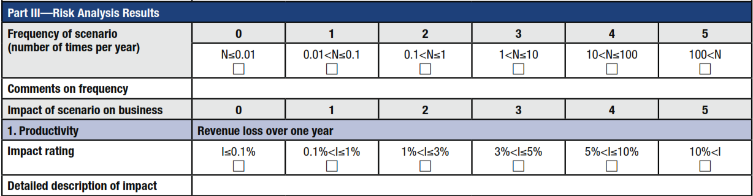
Template Risk Register Entry

Slide 33
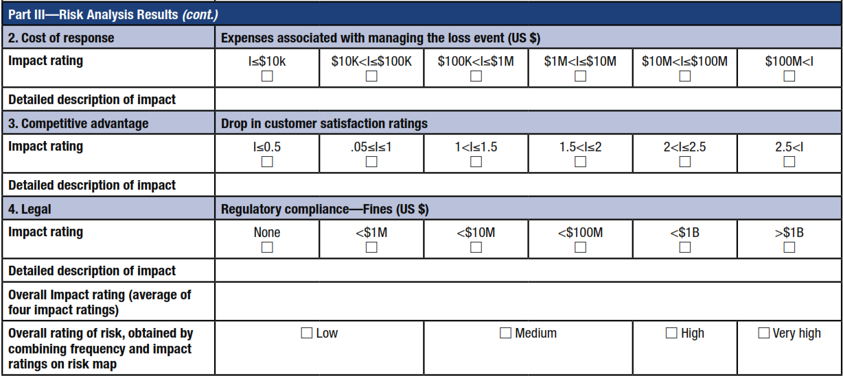
Template Risk Register Entry

Slide 34
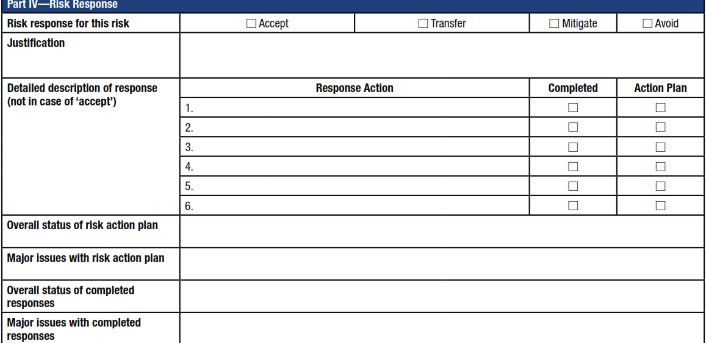
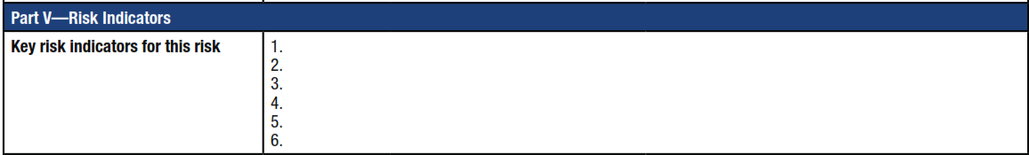
Template Risk Register Entry

Slide 35
Role of Audit
Internal & External audit should make a specialized Audit on a regular basis to assure the comprehensiveness and the effectiveness of the cybersecurity program and the implementation of the program.
External cybersecurity audit process must be performed at least annually for critical and high business impact services, while other services can be scheduled on three years’ audit plan.
The external auditors that are implementing external cybersecurity audit process must be changed every six years.

Slide 36
Incident Response Planning
An institution should determine decision-making responsibilities for incident response and implement clearly defined escalation and decision-making procedures.
Upon detection of a successful cyber incident or an attack attempt, an institution should perform a thorough investigation to determine its nature and the extent of damage.
It should take immediate containment actions and commence recovery efforts to restore operations based on its response planning.

Slide 37
‘Resumption Within Two Hours’
An institution should design and test its systems and processes to enable the safe resumption of critical operations within two hours (CBJ’s Instructions) of a disruption and to enable the completion of settlements by the end of the day of the disruption, even in the case of extreme but plausible scenarios. In doing so, an institution should exercise judgment in effecting resumption so that risks to itself or its ecosystem do not escalate.

Slide 38
Communication Planning
An institution should develop plans on how and what to communicate to participants, other institutions, the relevant authorities and other stakeholders in the event of a cyber incident.

Slide 39
Data Integrity Assessment and Design Considerations
Data integrity: An institution should have plans to identify the status of all transactions and its members’ positions at the time of a disruption.
It should design and test its systems to enable recovery of data following a breach, for example, by keeping copies of all received and processed data, maintaining transaction replay capability and conducting frequent periodic independent reconciliation of the participants’ positions.
Forensic readiness: An institution should establish and maintain incident logs to facilitate forensic investigations of cyber incidents.

Slide 40
Testing the Cyber Resilience
It is important that an institution tests its cyber resilience framework rigorously to assess its effectiveness on a regular basis.
Weaknesses and deficiencies identified from the testing process should prompt corrective actions so that its cyber resilience remains strong.
The tests can involve internal and external stakeholders. An institution should report the test results to its board and senior management.
  Vulnerability Assessment
  Scenario-based Test
  Penetration Test
  Red Team Test
  Industry-wide Test

Slide 41
Learning and Evolving
Learn from the past: institution s can learn a lot from successful cyber intrusions and near misses in terms of the methods used and vulnerabilities exploited by cyberattackers.
Stay up to date: institution s can acquire new knowledge and capabilities by monitoring technological developments and keeping abreast of new cyber risk management that can effectively counter existing and newly developed forms of cyberattack.
Foresee the future: institution can work towards achieving predictive capabilities and establishing proactive protection against future cyber events. Anticipation is based on analysing data and defining a baseline for behavioural and system activity to help detect anomalies.

Slide 42
Ten Security Tips To Mitigate Cyber Attack
Be alert | Use common sense and think twice before clicking links, opening attachments, visiting websites or responding to emails or phone calls. Many cyberattacks can be prevented if you take a moment to consider your actions and potential consequences.
Know how to identify phishing attempts | Be wary of emails or calls that require "immediate action" or ask for personal information. Carefully inspect links to make sure they point to a reputable site before clicking and never respond to messages asking for your username and password. Report suspicious emails to abuse@fsu.edu.
Use 2FA | FSU offers 2-factor authentication (2FA) for myFSU HR, employee email and other university applications. Consider adding this same protection to other sites or apps when available, such as your personal email or social media accounts. This extra layer of security requires you to verify your identity twice before accessing your account and can protect you from having your email hijacked or paycheck redirected.
Create strong passwords | Make a lengthy password using a combination of uppercase and lowercase letters, numbers and special characters. Use different passwords for different sites and consider using a password manager, such as LastPass, to store your passwords. Also, never share your password with anyone.
Lock your devices | Never leave your devices unattended. Password protect your phone or tablet and log off or lock your screen every time you step away from your computer.

Slide 43
Ten Security Tips To Mitigate Cyber Attack
Keep apps and software up to date | Talk with your IT support staff to make sure your work computer is programmed to automatically install updates. Do the same thing for your home computer and mobile devices, and regularly restart all devices to give them a chance to complete the update process.
Limit activities on public Wi-Fi | On campus, always connect to the FSU Secure network. When traveling, either use your cellular network, Eduroam or a virtual private network (VPN) to get secure internet access. If you must use a public network, make sure it is reputable and refrain from accessing sensitive information, such as online banking.
Back up your computer | Talk with the IT support staff in your unit and make sure there is a plan in place to back up your files and data regularly. Computers can utilize cloud storage or external hard drives to store copies of files. Either way, regular backup will protect you from losing all your work or research in the event of a ransomware attack.
Protect personal information | Do not store personally identifiable information—such as employee Social Security numbers, credit card numbers or student email addresses—on your computer unless it’s in an encrypted file.
Attend training |

Slide 44
شكرا

